Slide 1

Exploratory Data Analysis on
AMEO Data

Slide 2
Introduction:
Description of Data:
The dataset provides detailed candidate information, including unique identifiers (ID), annual salaries (Salary), dates of joining (DOJ) and leaving (DOL) the company, job titles (Designation), locations (JobCity), gender (Gender), and dates of birth (DOB).
Academic data includes grades in grade 10 (10percentage) and grade 12 (12percentage) exams, respective school boards (10board, 12board), college details (CollegeID, CollegeTier), degree pursued (Degree), and specialization (Specialization).
AMCAT test scores cover English, Logical, and Quantitative sections (English, Logical, Quant), a domain module score (Domain), and engineering sections (ComputerProgramming, ElectronicsAndSemicon, ComputerScience, MechanicalEngg, ElectricalEngg, TelecomEngg, CivilEngg).
Personality test scores include Conscientiousness, Agreeableness, Extraversion, Neuroticism, and Openness_to_experience.
Geographical details encompass college city ID and tier (CollegeCityID, CollegeCityTier), the state where the college is located (CollegeState), and the graduation year (GraduationYear) for Bachelor’s degree.
Objective:
The objective is to predict the salary (Annual CTC offered) based on the given independent variables such as cognitive skills, technical skills, personality traits, demographic features, educational background, and job-related details.
This is to be approached by Exploratory Data Analysis (EDA) on understanding the characteristics of the dataset and identifying potential relationships between the independent variables and the target variable (Salary).

Slide 3
About me
Background : I am a passionate and determined student With Masters in Computer Application, with Certification in Data Analytics. My curiosity drives me to deepen my understanding of data analysis and machine learning, and I’m excited to explore the endless possibilities these fields offer.
Why you want to learn Data Science: I want to learn Data Science because I am deeply fascinated by the power of data to drive meaningful insights and decision-making. In today's data-driven world, the ability to analyze and interpret complex datasets is crucial. I am eager to harness this potential to solve real-world problems and contribute positively to various fields, whether it's in healthcare, finance, or technology.
Share your linkedin and github profile urls: You can connect with me on LinkedIn and explore my projects on GitHub:
➢ LinkedIn: www.linkedin.com/in/yuvrajkadam619
➢ GitHub: https://github.com/yuvi666

Slide 4
Agenda:
Business Problem and Use case domain understanding Business Problem: In today's competitive job market, it's important for schools and companies to know what affects the salaries of new graduates. This study looks at how different factors like education and personal traits influence starting pay. Use Case Domain: This project concentrates on the education and job fields, particularly examining the connection between educational background, skills, and salary for engineering graduates.
Objective of the Project The primary objective of this exploratory data analysis is to uncover insights related to salary distributions and the influence of various features on the target variable, Salary. Specifically, the analysis aims to:
➢ Conduct a univariate analysis to understand the distribution and characteristics of the Salary variable.
➢ Perform a bivariate analysis to explore relationships between Salary and other relevant features, including gender, specialization, and years of experience.
➢ Investigate whether the statement from the Times of India regarding potential salaries for Computer Science Engineering graduates holds true in the context of this dataset.
➢ Examine the relationship between gender and specialization to determine if there are any discernible patterns. Through this analysis, we aim to provide valuable insights that could inform both individuals seeking to enter the job market and organizations aiming to understand salary trends.

Slide 5
Agenda:
Summary of the Data Size:
The dataset includes about 4,000 records of engineering graduates, each with various details about their education and personal characteristics.
Key Information:
✓ Salary (main focus)
✓ Gender
✓ Field of Study
✓ College Level
✓ Technical Test Scores (like English, Logical Reasoning, Math)
✓ Personality Traits (such as being organized, friendly)
Types of Data:
✓ Numbers: Salary, test scores, percentages.
✓ Categories: Gender, field of study, college level, etc.
Missing Data: The dataset was reviewed for missing information, and necessary steps (like filling in gaps or removing incomplete records) were taken to fix this

Slide 6
Exploratory Data Analysis:

Slide 7
Data Cleaning Steps: ➢ Import Libraries: Load the required libraries like pandas, numpy, matplotlib, and seaborn. ➢ Load Dataset: Read the dataset using pd.read_csv() or the suitable function for your data format. ➢ Check for Missing Values: • Usedf.isnull().sum() to find columns with missing values. • Choose a method to deal with missing values (e.g., delete them, fill them in). ➢ Remove Duplicates: • Usedf.drop_duplicates() to get rid of duplicate entries in the dataset. ➢ CorrectDataTypes: • Check and change datatypes if needed using df.astype(). • Fordatecolumns,change them to datetime format using pd.to_datetime(). ➢ Outlier Detection : • Use methods like IQR(Interquartile Range) or Z-score to find outliers innumerical columns.

Slide 8
Univariate Analysis ➢ Understanding Numerical Data: ▪ Make histograms and density plots to see how numerical data (like salary and technical scores) is spread out. ▪ Use box plots to show any unusual data points (outliers) and how the data is spread. ➢ Visualizing Categorical Data: ▪ Create count plots for categories like gender or specialization to see how they are spread out.

Slide 9
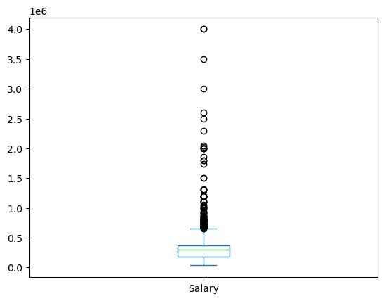
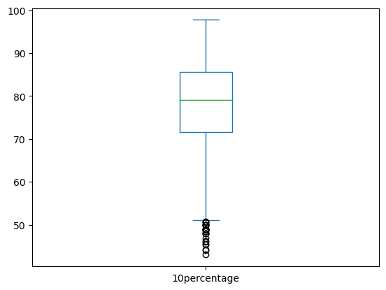
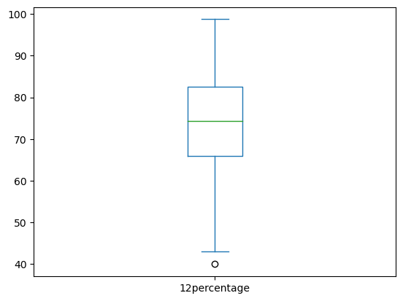
Observations:
Salary:
The salary ranges from 35,000 to 4,000,000 with a mean of approximately 307,700.
The median salary is 300,000, indicating that half of the individuals earn below this amount and half earn above it.
There are many outliers in the Salary as we can see from the box plot indicating major variation in salaries of the people.
Educational Performance:
The 10th and 12th percentages have means around 77.9 and 74.5 respectively, with standard deviations of approximately 9.9 and 11.0.
The mean college GPA is 71.5 with a standard deviation of around 8.2.
In the 10th percentage, there are outliers where the percentage is less than 60% indicating that some individuals had the percentage below 60%.
In the 12th percentage there is a single outlier where the percentage of the individual is less than 40%.

Slide 10
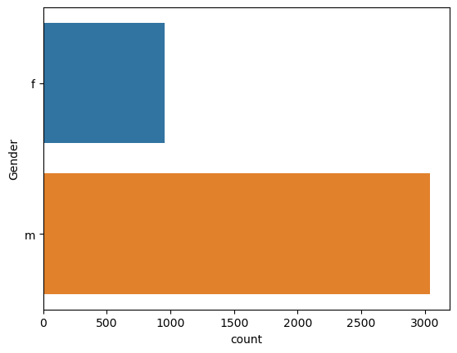
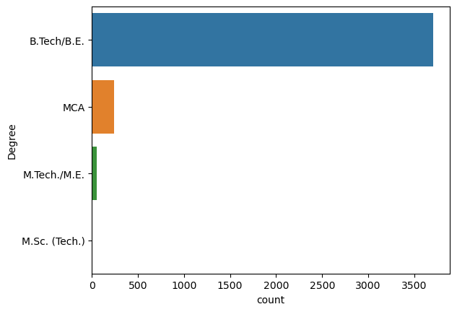
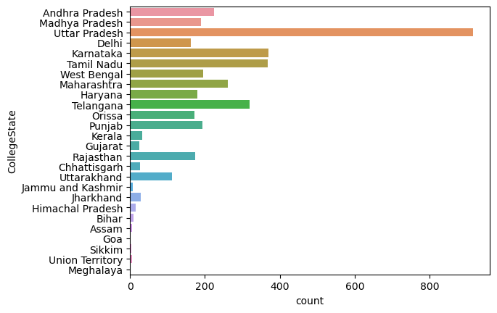
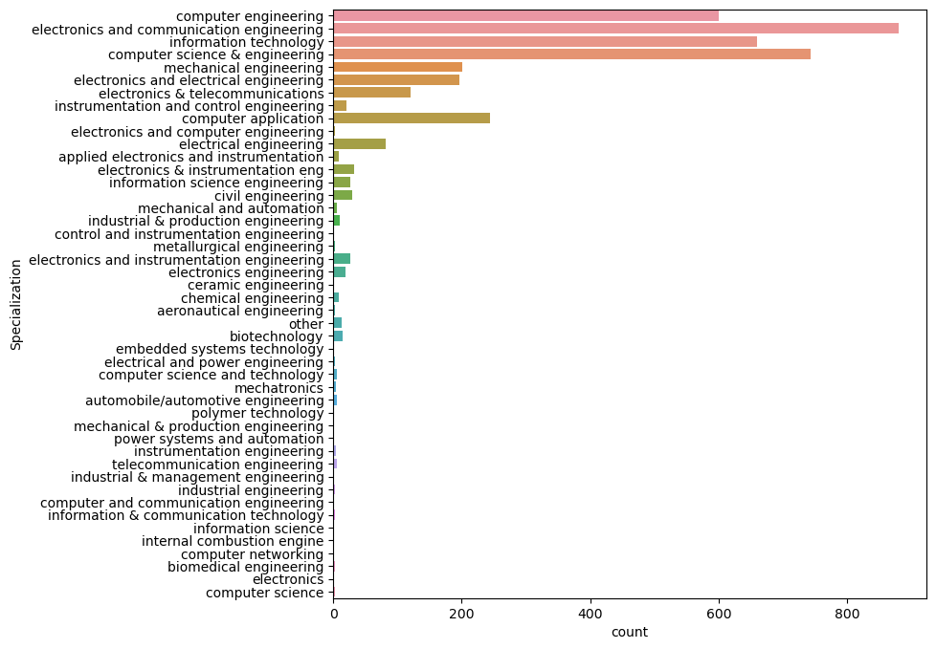
Observations:
Gender Distribution:
There are two unique genders: 'm' and 'f'.
The majority of individuals are male ('m'), while approximately are female ('f').
Degree:
There are four unique degrees: 'B.Tech/B.E.', 'MCA', 'M.Tech./M.E.', and 'M.Sc. (Tech.)'.
'B.Tech/B.E.' is the most common degree.
'MCA' (Master of Computer Applications) is the next most common degree.
'M.Tech./M.E.' (Master of Technology/Master of Engineering) and 'M.Sc. (Tech.)' (Master of Science in Technology) are less common.
Specialization:
There are 46 unique specializations.
The most common specializations include 'electronics and communication engineering', 'computer science & engineering', 'information technology', and 'computer engineering'.
'electronics and communication engineering' is the most prevalent specialization, followed by 'computer science & engineering' and 'information technology'.
College State:
There are 26 unique states where colleges are located.
The top states represented in the dataset are Uttar Pradesh, Karnataka, Tamil Nadu, Telangana, and Maharashtra.
Uttar Pradesh has the highest representation, followed by Karnataka and Tamil Nadu.

Slide 11
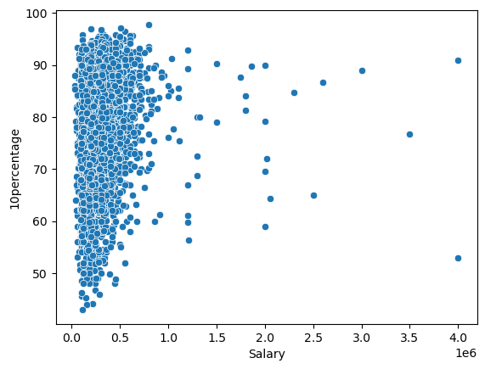
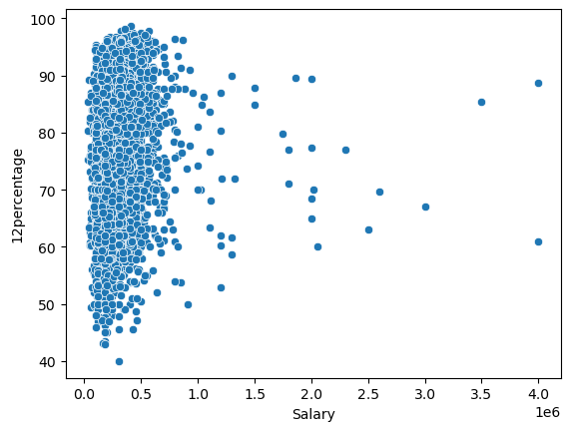
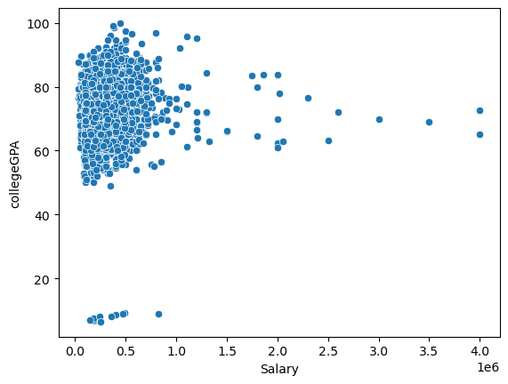
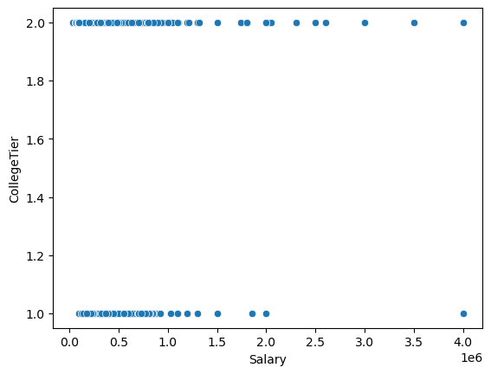
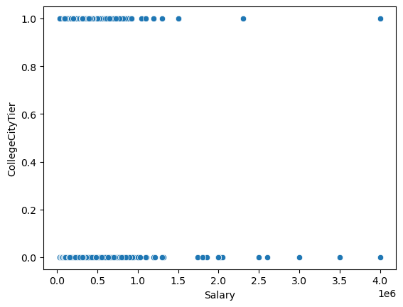
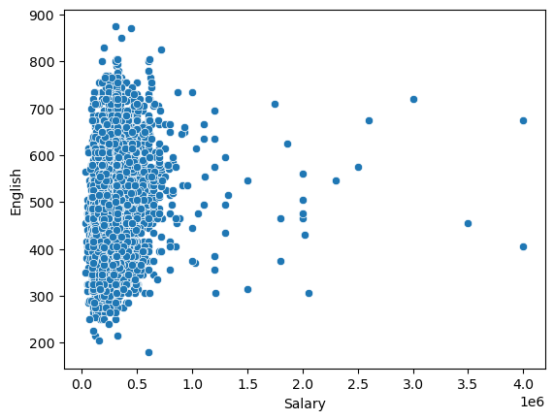
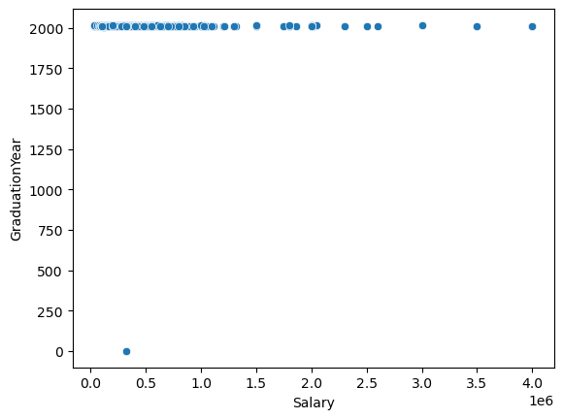
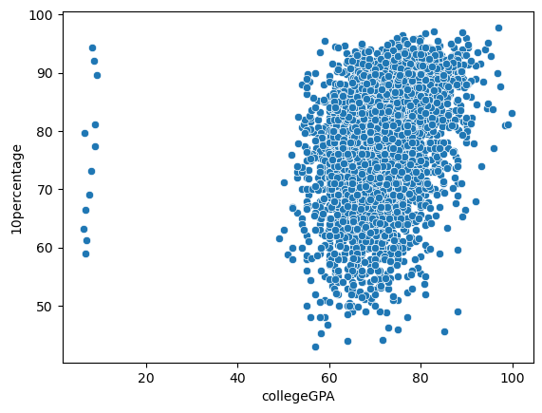
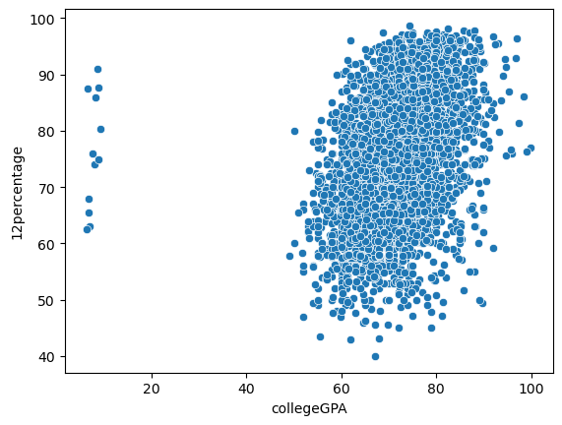
Bivariate Analysis:
Observations:
The scatter plots show the relationship between various academic and professional factors and an individual's salary. Some of the factors include college tier, college GPA, city tier, English score.
We can also see there is positive relation between 10th ,12th percentage and college GPA, who have good 10th and 12th percentage mostly perform good in college too.
Also we can see there is no such connection between salary and English.
There is correlation between College Tier and Salary. So we can assume people from good tier colleges get higher package compared to others.

Slide 12
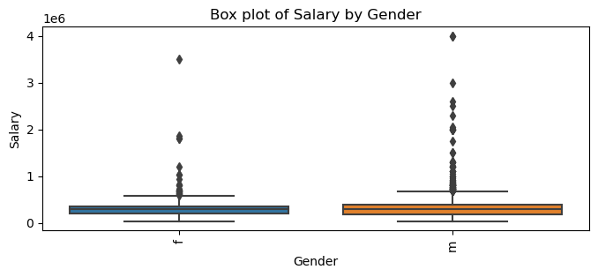
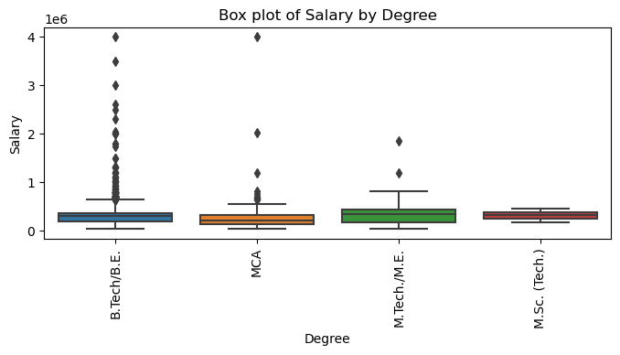
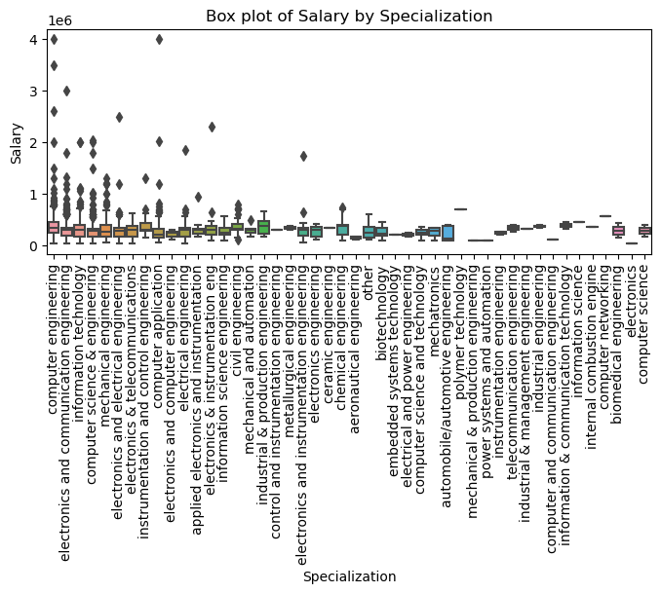
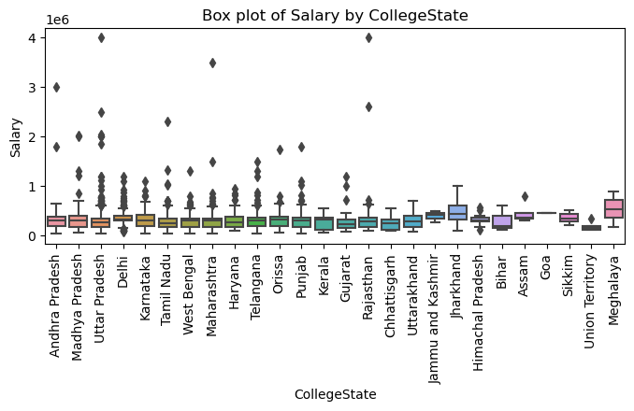
Observations:
From the above graphs, we can observe the relationship between salary and gender, degree, specialization, and college state of the individual.
Most of the individuals identified as 'Male' have the highest salary of 4000000, compared to females who have the highest salary range between 3000000 and 4000000.
There are many outliers indicating extreme salaries for certain male and female individuals.
Individuals with a B.Tech/B.E. degree have the highest salaries, followed by MCA and M.Tech./M.E. graduates. M.Sc. graduates * tend to have the lowest salaries.
Within the engineering field, individuals with a B.Tech/BE in computer engineering, followed by computer application graduates, have the highest salaries.
Individuals who pursued their degrees in colleges in Uttar Pradesh have the highest salaries, followed by those in Rajasthan and Andhra Pradesh.

Slide 13
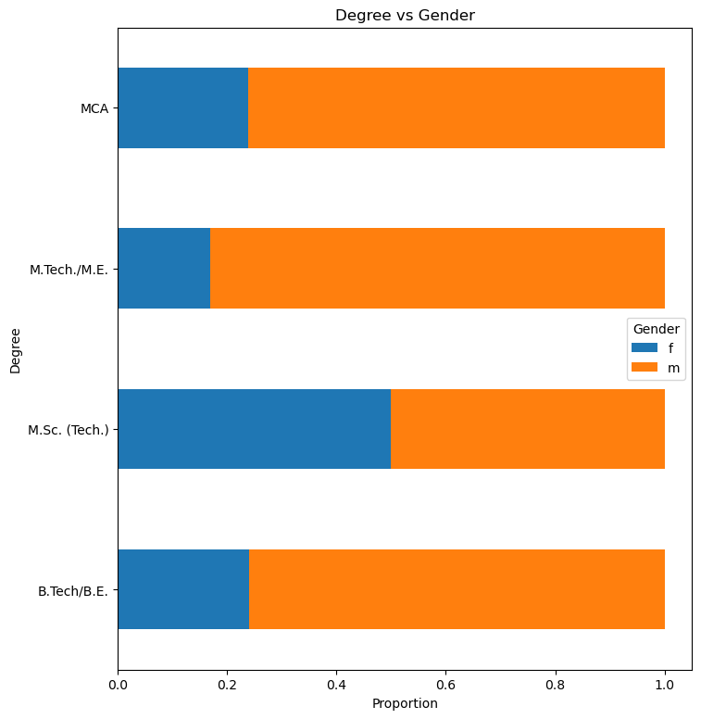
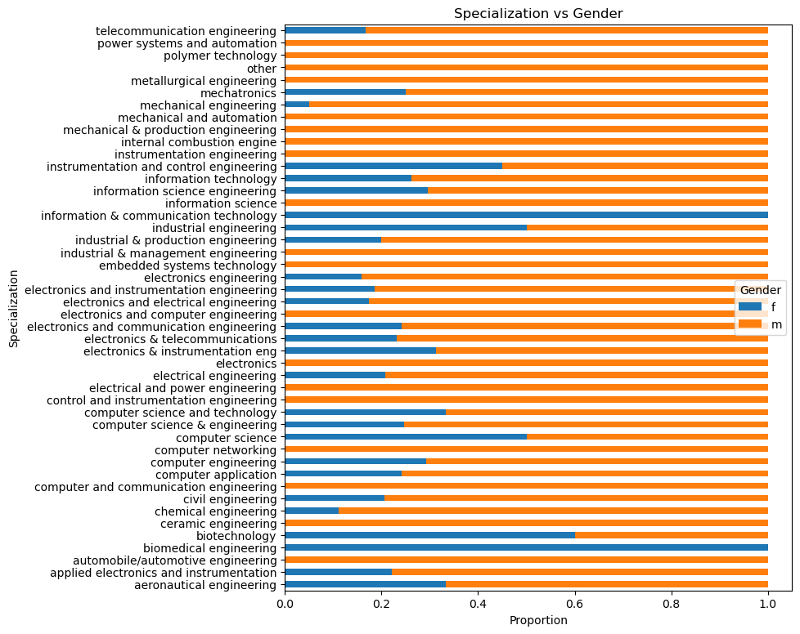
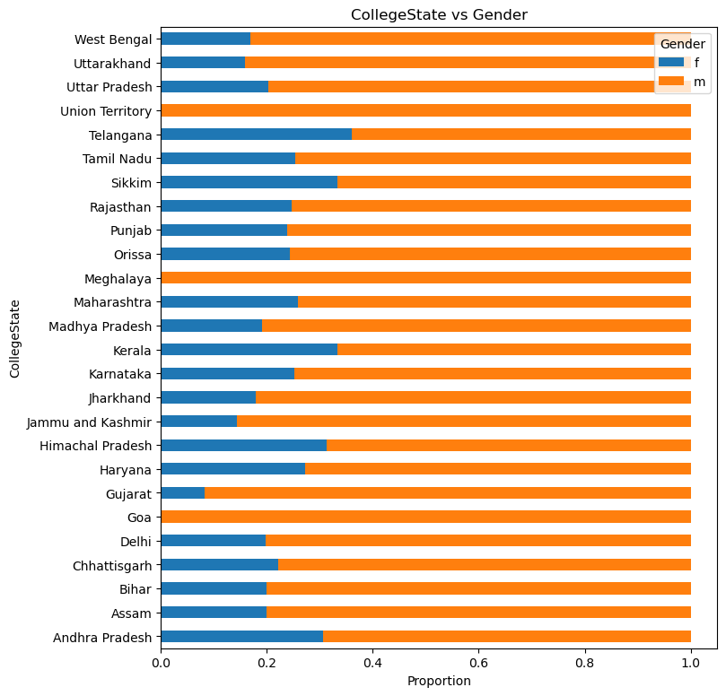
Observations:
Degree:
B.Tech/B.E. and MCA are predominantly pursued by males.
M.Tech./M.E. has a higher male representation compared to females.
Males are also more predominant in the Computer Science fields like Computer Engineering and Information Technology.
Specialization:
Fields like Automobile/Automotive Engineering and Electronics Engineering are entirely male-dominated .
Biomedical Engineering and Information & Communication Technology are represented solely by females .
Some fields like Computer Science and Telecommunication Engineering have an equal gender split.
CollegeState:
States like Goa, Meghalaya, and Union Territories show a complete male representation (100%).
States such as Andhra Pradesh (69.33% male), Gujarat (91.67% male), and Telangana (63.95% male) are predominantly male.
Kerala (66.67% male) and Tamil Nadu (74.66% male) have a higher male representation, while states like Himachal Pradesh (31.25% male) and Sikkim (66.67% male) show a more balanced gender ratio.

Slide 14
Is there a relationship between gender and specialization? (i.e. Does the preference of Specialisation depend on the Gender?)
Important Business Questions:
As Analyzed on above analysis preference of Specialization does depend on Gender, because Fields like Automobile/Automotive Engineering and Electronics Engineering are entirely male-dominated.
But Also on the other hand Biomedical Engineering and Information & Communication Technology are represented solely by females.
Is there a relationship between Gender and Salary?
Yes there is pay gap between genders , that we can observe using analysis.
Male Have More pay scale than Females,This can be also Due to Number(Count) of males is Greater than that of Females.

Slide 15

THANK YOU

